Slide 1
Corona Travel
Everything is awesome
Task 5

Slide 2
Product description
Our goal in to allow users to travel online from home via any device of their liking. They'll start by opening an app or a link and choosing a desired destination. After choosing a location, users can choose to view destination in 3D, look at some 3D photos or videos or learn some facts about the place.
Team: Artem Filimonov, Danil Kireev, Elena Karelina, Sofya Donskaya
Project repo: https://github.com/randomunrandom/corona_travel
This report: https://docs.google.com/presentation/d/1QC14KO-1_a8kRqRROmUVReOf_kfE20z5xqTBuCWW4wY/edit?usp=sharing

Slide 3
Story map
As a <Sergey>
I want to <travel abroad, observe nature and visit new places>
So that <I will gain a new experience and will not spend much time and money>
I want to <choose the destination and go to explore new sights>
So that <I will be surrounded by nice landscapes>
I want to <listen to nice sounds and enjoy waterfalls>
So that <I can relax after work>
As a result I have relaxed and start loving my children again :Ↄ
As a <Lena>
I want to <relax after my work and studying>
So that <I will be recharged for the next day>
I want to <move to another country and get known with historical facts and have a fun time by solving quiz>
So that <I will gain knowledge and experience>
As a result I have done it and enjoyed my life :)

Slide 4
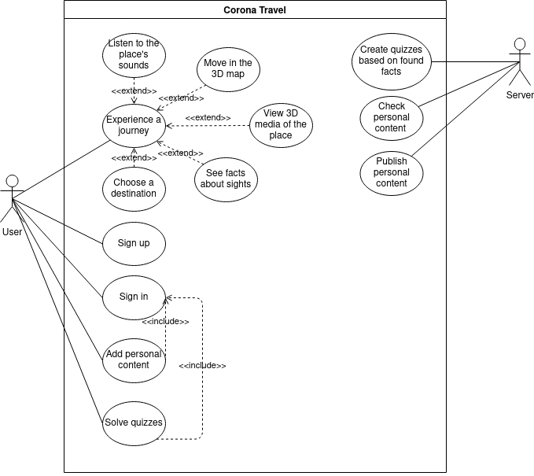
Use case diagram

Slide 5
Class candidates (problem domain)
Candidate | Criteria | Stored information | Operations
User | SIOAT | name, hash of a password, quiz results, visited places | login, CRUD place, CRUD quiz, view media
Place | SIOAUT | location, list of facts, list of quizes, name, 3d-media, sounds | add, add fact, add media, add quiz
Location - duplicate of Place
Destination - duplicate of Place
3-D media | SOT | name, author, metadata | CRD
Sound | SOT | name, duration, author | CRD
Fact | SOT | place, qestion4quiz, answers4quiz | CRUD
Map | SIT | list of places, list of journeys | add place, remove place, move to
Journey | SIOAU | name, date started, list of places, list of quizes | create, add place, remove place, add quiz, remove quiz, postpone
Quiz | SIOAUT | list of facts, name, author | solve, create, add fact

Slide 6
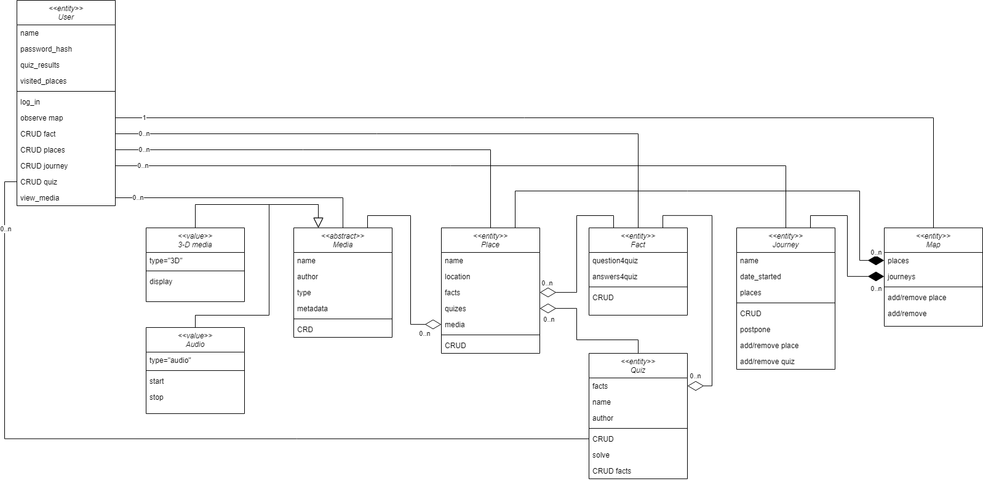
Domain model diagram

